Slide 1
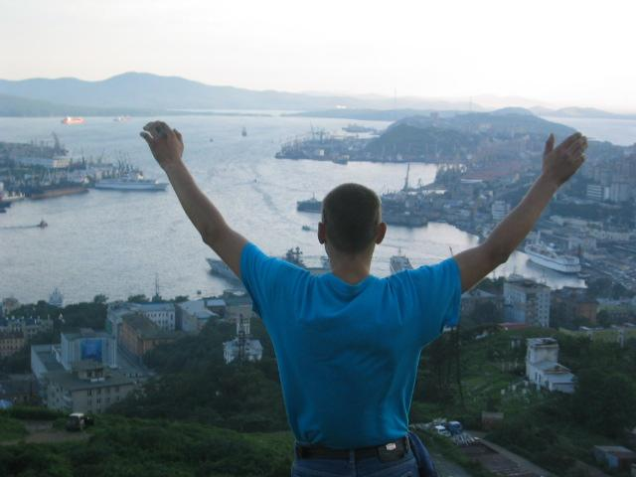
Stopping Cities to Welcome the King
25 Sep - 5 Oct 2022
Coming together in John 17 unity to
Mourn over our sin in repentance
Mourn for the lost & unreached
Yearn for the reconnection of the Jews into the Body of Messiah
Yearn for the fulfillment of God’s promises
Yearn for the return of Our Bridegroom JESUS CHRIST

Slide 2
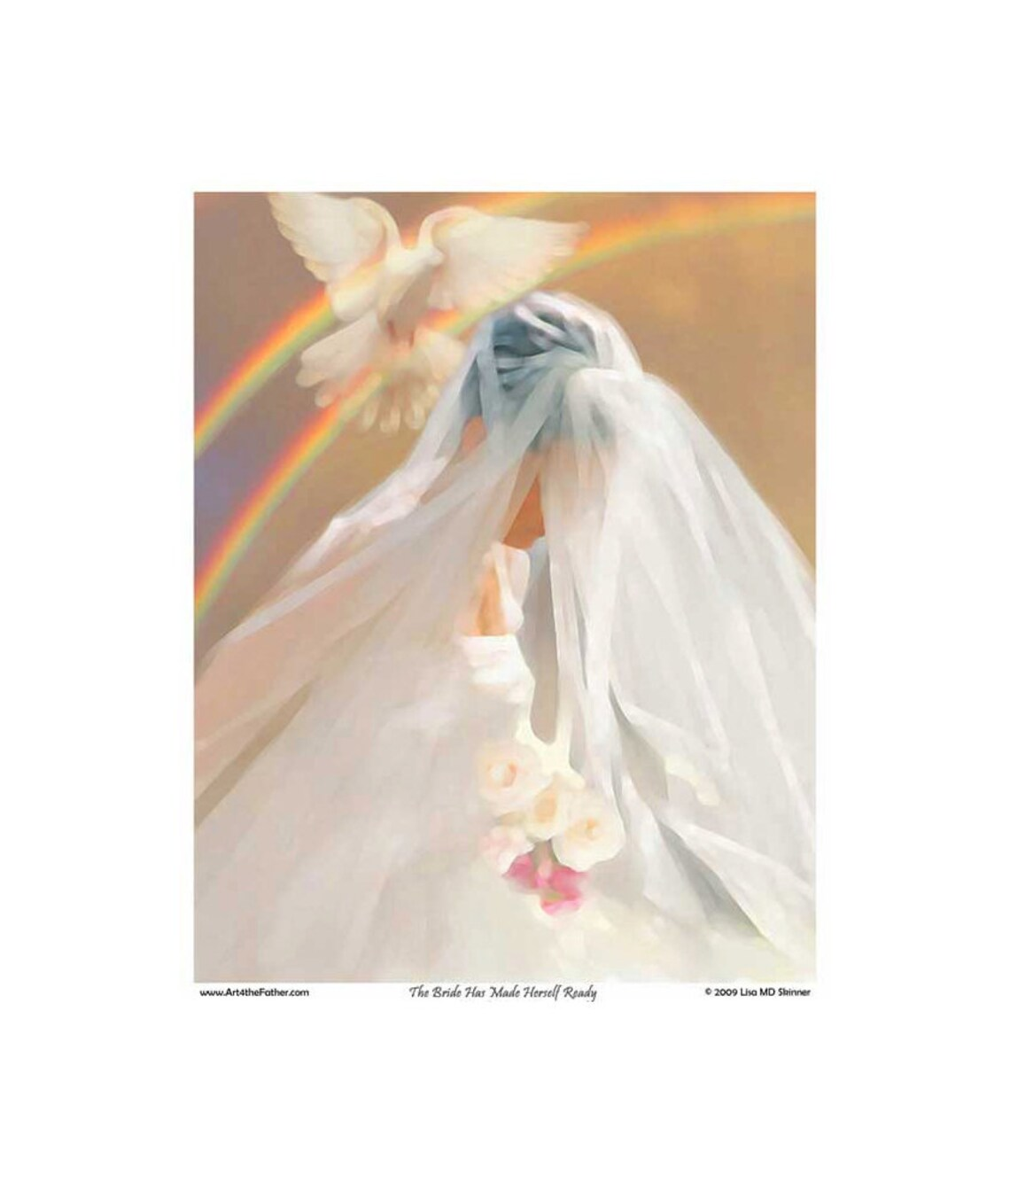
The Bride is making herself ready...
Whether we join together physically... Or virtually...
As we come together before the Throne, The Holy Spirit works in and among us...
We are transformed from glory to glory in His Presence.

Slide 3
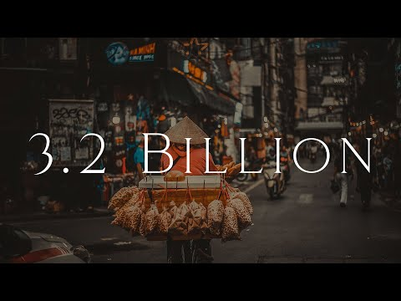
But NOT EVERYONE has had even ONE CHANCE to receive God’s gift of salvation through Jesus Christ….

Slide 4
YOUR PRAYERS CHANGE THAT!!
Final 10-15 Minutes
Yearning for the Fulfillment of God’s Promises & Jesus’ Return
Opening 10-15 Minutes
Praise, Worship & Repentance
Intercession 20-30 Minutes
Unity, Holy Spirit Outpouring, the Jews & Israel,
the Unreached, Nations & Neighbors

Slide 5
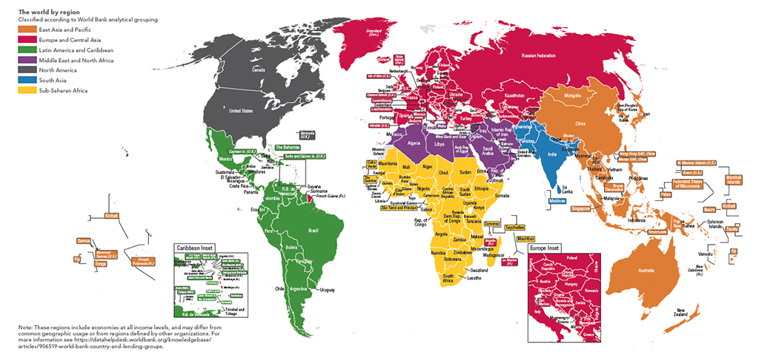
ONE DAY, ONE REGION
“From the rising of the sun unto the going down of the same the LORD'S name is to be praised. The LORD is high above all nations, and his glory above the heavens. Who is like unto the LORD our God, who dwelleth on high, ⁶Who humbleth himself to behold the things that are in heaven, and in the earth!”
Psalm 113:3

Slide 6
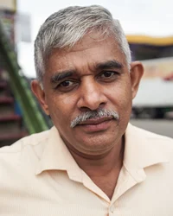
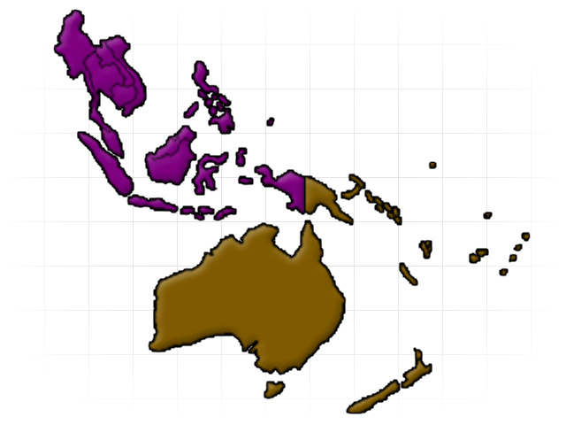
DAY 1: REGION 1 South Pacific/Southeast Asia
38 nations - 49.7% Unreached
756 UPG’s - 329M Population Unreached
Believers to Abide & Bear Much Fruit: I am the vine; you are the branches. If you remain in me and I in you, you will bear much fruit; apart from me you can do nothing. John 15:5
Increased Power in Unity among Believers Five of you will chase a hundred, and a hundred of you will chase ten thousand.... Leviticus 26:8
Widespread Revelation of the glory of the Lord: For the earth will be filled with the knowledge of the glory of the Lord as the waters cover the sea.” Habakkuk 2:14
Sinhalese of Australia

Slide 7
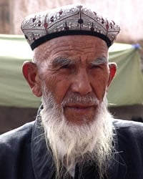
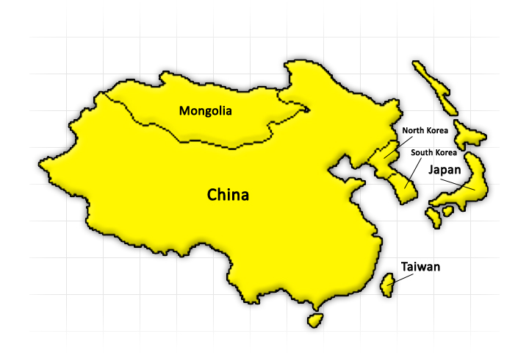
DAY 2: REGION 2 Northeast Asia 8 nations/528 UPGs/74.5% unreached/307M pop. unreached
Faith-filled Expectation for Harvest “Have faith in God,” Jesus answered. “Truly I tell you, if anyone says to this mountain, ‘Go, throw yourself into the sea,’ and does not doubt in their heart but believes that what they say will happen, it will be done for them.” Mark 11:22-23
Strongholds Torn Down “The weapons we fight with are not the weapons of the world. On the contrary, they have divine power to demolish strongholds.” 2 Corinthians 10:3-4
People of Peace & Provision “Stay there, eating and drinking whatever they give you, for the worker deserves his wages. Do not move around from house to house.” Luke 10:7
Uyghur of China

Slide 8
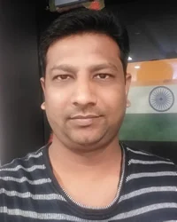
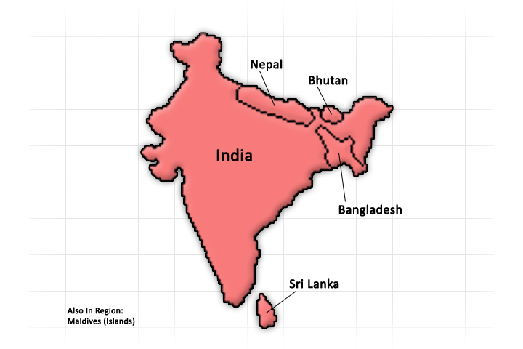
Day 3: REGION 3 South Asia
8 nations/1.7B population unreached 3,477 UPG’s/89.3% unreached
Workers He told them, “The harvest is plentiful, but the workers are few. Ask the Lord of the harvest, therefore, to send out workers into his harvest field. Luke 10:2
Abiding Fruit But the seed falling on good soil refers to someone who hears the word and understands it. This is the one who produces a crop, yielding a hundred, sixty or thirty times what was sown. Matthew 13:23
Enduring Suffering Not only so, but we also glory in our sufferings, because we know that suffering produces perseverance; perseverance, character; and character, hope. And hope does not put us to shame, because God’s love has been poured out into our hearts through the Holy Spirit, who has been given to us. Romans 5:3-5
Shaikh of India

Slide 9
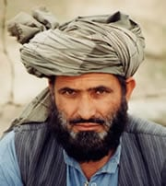
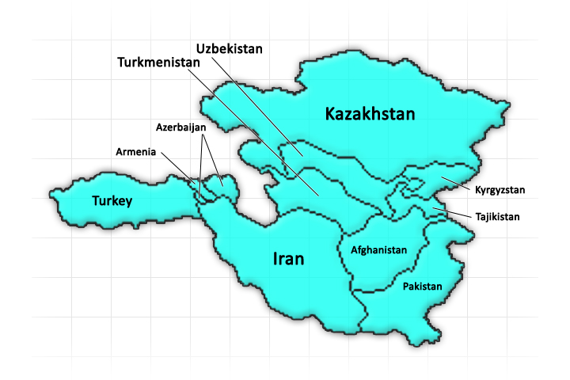
Day 4: REGION 4 Central Asia 10 nations ⬧ 278M population unreached⬧ 367 UPG’s
68.1% unreached
None to Perish The Lord is not slow in keeping his promise, as some understand slowness. Instead he is patient with you, not wanting anyone to perish, but everyone to come to repentance. 2 Peter 3:9
Unveil their Eyes The god of this age has blinded the minds of unbelievers, so that they cannot see the light of the gospel that displays the glory of Christ, who is the image of God. 2 Corinthians 4:4
Laborers in the Harvest He told them, “The harvest is plentiful, but the workers are few. Ask the Lord of the harvest, therefore, to send out workers into his harvest field. Luke 10:2
Southern Pashtun of Afghanistan

Slide 10
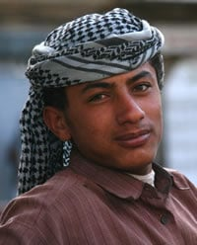
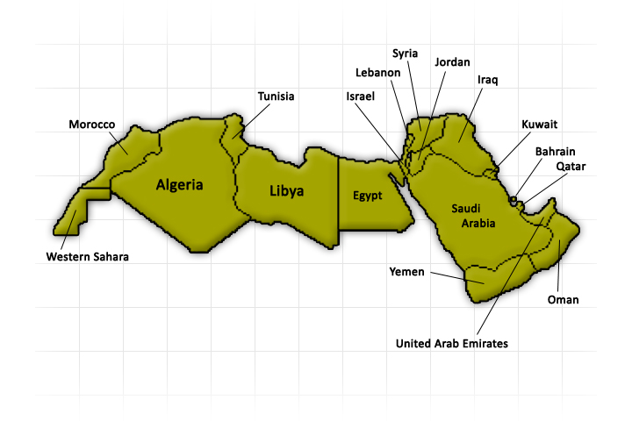
Day 5: REGION 5 North Africa/Middle East 19 nations ⬧ 260M population unreached⬧ 385 UPG’s
67.2% unreached
Bold Witness “Paul entered the synagogue and spoke boldly there for three months, arguing persuasively about the kingdom of God. But some of them became obstinate; they refused to believer and publicly maligned the Way. So Paul left them. He took the disciples with him and had discussions daily in the lecture hall of Tyrannus. This went on for two years, so that all the Jews and Greeks who lived in the province of Asia heard the word of the Lord.” Acts 19:8-10
N Yemeni Arabs of Saudi Arabia

Slide 11
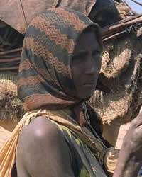
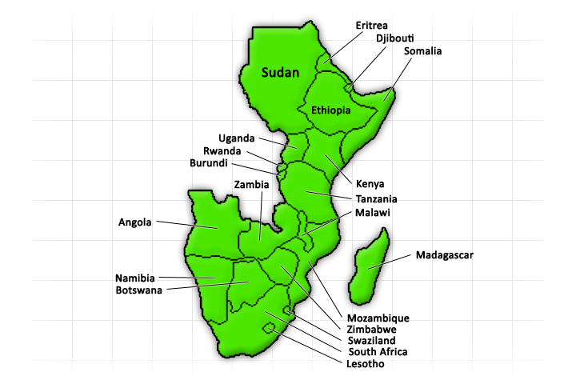
Day 6: REGION 6 East & Southern Africa 28 nations ⬧ 93M population unreached⬧ 349 UPG’s
26.9% unreached
Gospel Shared Widely Then they said one to another, We do not well; this day is a day of good tidings, and we hold our peace; if we tarry till the morning light, some mischief will come upon us; now therefore come, that we may go and tell the king’s household. 2 Kings 7:9
Hungry Hearts to Respond So, they requested, “we would see Jesus...John 12:21
Multiplying movements. So Paul left them. He took the disciples with him and had discussions daily in the lecture hall of Tyrannus. This went on for two years, so that all the Jews and Greeks who lived in the province of Asia heard the word of the Lord.”Acts 19:9-10
Rahanweyn of Somalia

Slide 12
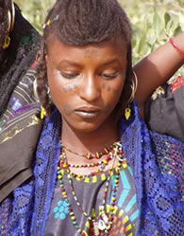
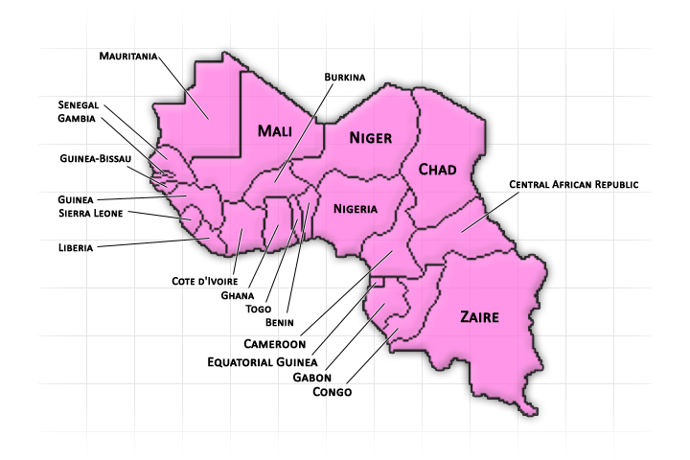
Day 7: REGION 7 West & Central Africa 24 nations ⬧ 168M population unreached ⬧ 499 UPG’s 22.4% unreached
Declare Your Glory among the peoples, your marvelous works among all the peoples in this region. For great are you Lord, and greatly to be praised! You are to be feared above all gods. For you, Lord God, are most high above all the earth. You are exalted far above all gods. Psalms 96:3, 4; 97:9
Rescue every man, woman, and child in every people group in West & Central Africa from the dominion of darkness and bring them into the kingdom of his dear Son, Jesus Christ. Colossians 1:13
Let Your Kingdom come and Your will be done throughout West & Central Africa...
Nigerian Fulani

Slide 13
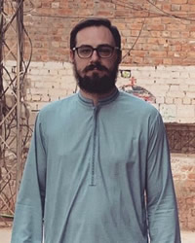
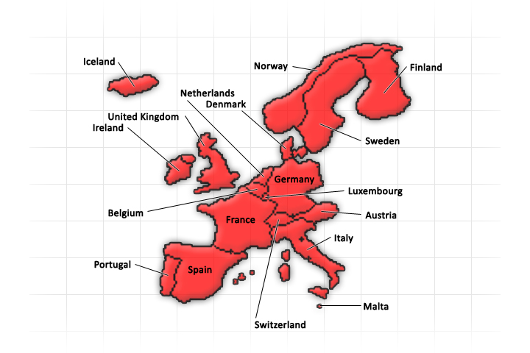
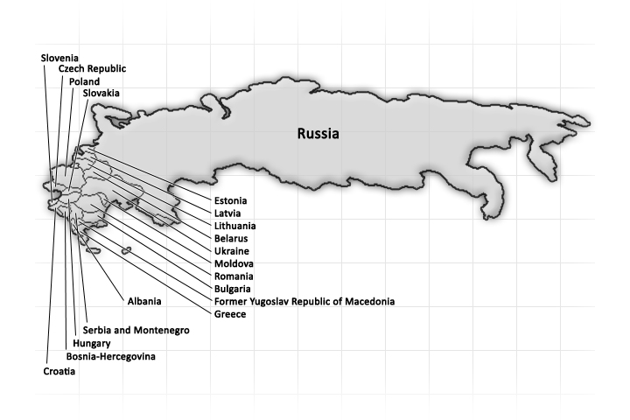
Day 8: REGION 8 Eurasia/Europe 51 nations / 42M population unreached / 558 UPGs 28% unreached
No Place Left The Lord is not slow in keeping his promise, as some understand slowness. Instead he is patient with you, not wanting anyone to perish, but everyone to come to repentance. 2 Peter 3:9
Open their Eyes The god of this age has blinded the minds of unbelievers, so that they cannot see the light of the gospel that displays the glory of Christ, who is the image of God. 2 Corinthians 4:4
Thrust Out Workers He told them, “The harvest is plentiful, but the workers are few. Ask the Lord of the harvest, therefore, to send out workers into his harvest field. Luke 10:2
Chechen of Russia

Slide 14
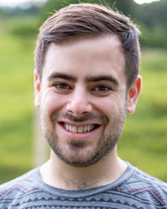
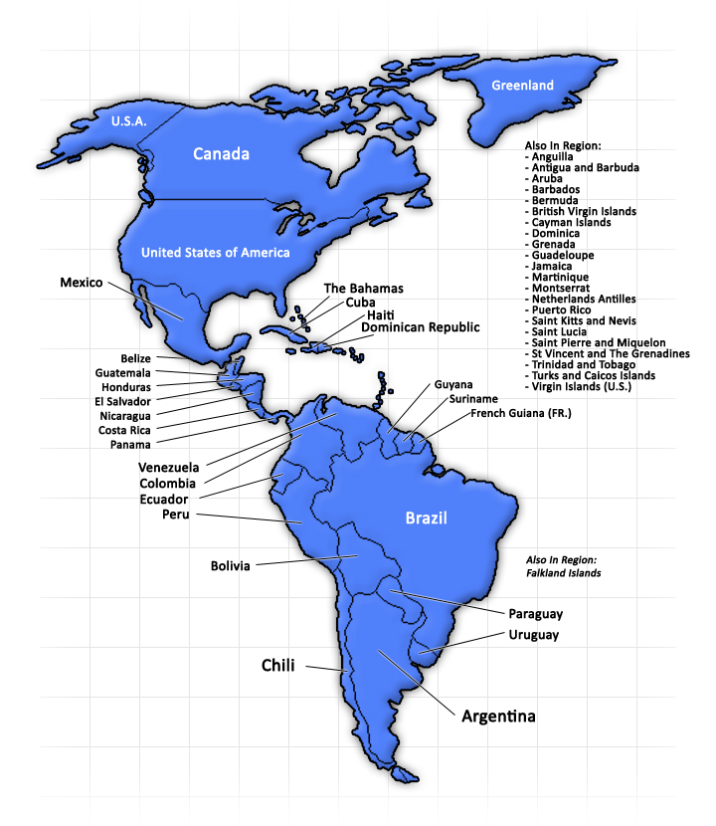
Day 9: REGION 9 Latin America 22 nations ⬧ 1M population unreached ⬧ 88 UPG’s 6.2% unreached
Light for All Lord, you sent Jesus as a witness to testify about the light so that all the peoples of Latin America might believe through him. He is the light for revelation to each one, man, woman, and child, announcing to them that God is light, and in him is no darkness at all. John 1:7; Luke 2:32; 1 John1:5
Deliverance Deliver the peoples of Latin America from the dominion of darkness and bring them into the kingdom of the Son You love, Jesus Christ. Colossians 1:13
Good Soil Let the Good News come to each one, falling on good soil, where it produces a crop--a hundred, sixty or thirty times what was sown. Matthew 13:8
Portuguese-speaking Jews of Brazil

Slide 15
Day 10: REGION 10 North America/Caribbean 30 nations ⬧ 7M population unreached ⬧ 141 UPG’s 14.4% unreached
Open Eyes The god of this age has blinded the minds of unbelievers, so that they cannot see the light of the gospel that displays the glory of Christ, who is the image of God. 2 Corinthians 4:4
Abundant Harvest He told them, “The harvest is plentiful, but the workers are few. Ask the Lord of the harvest, therefore, to send out workers into his harvest field. Luke 10:2
Jesus’ Kingdom Come The seventh angel sounded his trumpet, and there were loud voices in heaven, which said: “The kingdom of this world has become the kingdom of our Lord and of his Messiah, and he will reign for ever and ever.” Revelation 11:15
Urdu-speaking Muslims of the United States

Slide 16
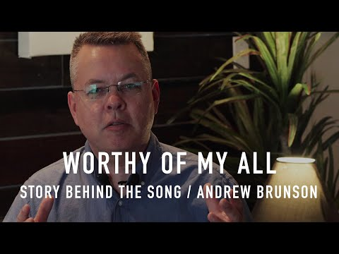
Andrew Brunson wrote this song in Buca Maximum Security Prison 2 weeks after the Turkish government falsely accused him of being a spy and helping to lead a coup attempt. These charges carried an automatic 3 life sentences in solitary confinement with no parole. Andrew sang this song every day after of his 2 years in prison.

Slide 17
